Slide 1


Emergent Gaming Technologies Week 10 - A: Design Document
Design Document

Slide 2
This lecture will cover
Emergent Gaming Technologies: Week 10-A
Topics
What to include on the design document?
Overview of the project
Intended goals of the project
Description of the artefact
Describe the technology and reasons why it was chosen
Development methodology.
User requirements
User guide: How to set up and use the artefact.
Marking Criteria

Slide 3
Overview of the Project
Emergent Gaming Technologies: Week 10-A
Provide a small summary of your project in which you mention
What is your project?
What does it do?
Which technology was implemented?
Key features.
Think of the overview as your sales pitch. Short but interesting to catch the attention of the reader.

Slide 4
Intended goals of the project
Emergent Gaming Technologies: Week 10-A
Describe what are the aims of the project. Examples:
Learn how to implement a new technology : Explain why.
Produce a tool that can be used by other GameDevelopers: Explain how can your tool improve development workflow.
Produce an educational activity: How does your project can be used as a learning tool.
Serious Gaming:
Produce a training application: How does your project can be used to train new skills.
Medical research: Can you application be used to study human diseases or as a rehabilitation tool?

Slide 5
Description of the artefact
Emergent Gaming Technologies: Week 10-A
Provide a detailed description of your application:
Which software development environment did you use to produce your application? : Visual Studio, GameEnginges (Unreal, Unity).
Which programming language?: C#, Python, C++ .
Which technology are you using?.
Describe the mechanics of your application. If relevant, provide a library of gestures. (For Leap Motion, MYO, Kinect, IMU). Use of a Flow Chart is highly recommended.

Slide 6
Description of the technology
Emergent Gaming Technologies: Week 10-A
Provide a detailed description of the used technology:
What is it?.
How does it works?.
Recommended conditions of use.
Why did you choose this/these particular technology/ies ?.

Slide 7

Methodology
Emergent Gaming Technologies: Week 10-A
Provide a detailed list of steps you carried in order to produce your application, from research to delivery.
Workflow
<http://moveableonline.com/blog/assets/2016/09/workflow.gif>
The use of GanntChart is highly recommended.

Slide 8
User Requirements
Emergent Gaming Technologies: Week 10-A
Provide a list of both software and hardware needed for the final user to smoothly run your application.
The list should include, but it is not limited to, the system requirements of the chosen technology.

Slide 9
User Guide
Emergent Gaming Technologies: Week 10-A
Provide a comprehensive guide on how to set up and run your application.
Does the user need any special equipment (software/hardware) prior the installation or use of your application?. Mention it at the beginning of the guide.
The guide should be clear enough for a computer illiterate to successfully set up and run your application. Use of pictures, images, screenshots is highly recommended.

Slide 10
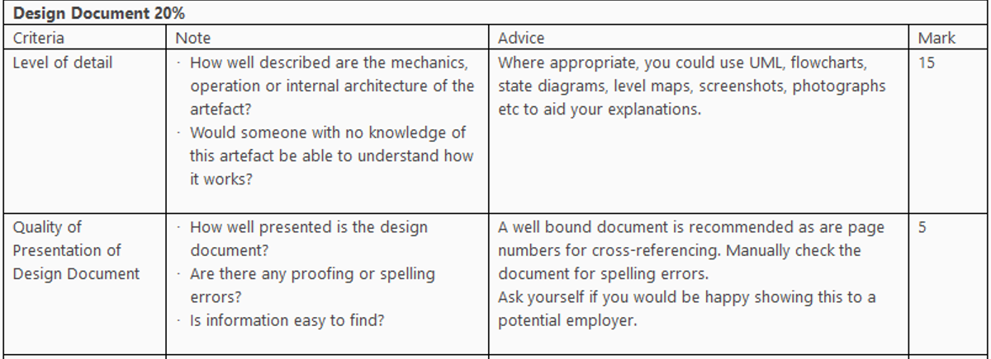
Marking Criteria
Emergent Gaming Technologies: Week 10-A

Slide 11

Questions?
Emergent Gaming Technologies: Week 10-A

